Slide 3


Pablo Peris
Microsoft
Senior Engagement Manager
Microsoft Newbie
SharePoint Veteran
@pabloperis

Slide 4
Gestión ‘Bottom-up’ del conocimiento: Boards, Delve y Office Graph

Slide 5

¿En serio hacía falta poner un título tan largo?

Slide 6
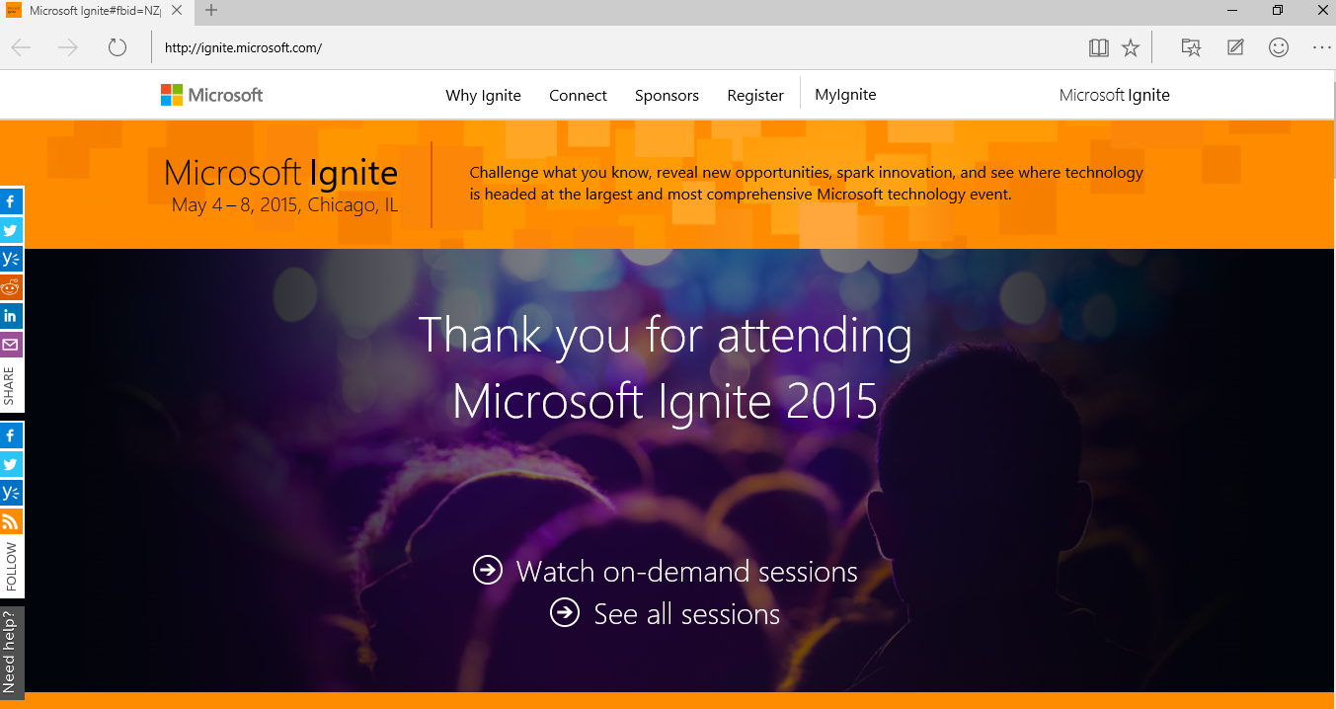

Slide 7
Disclaimer: All based on Ignite Sessions
Tuesday (5/5/2015)
BRK2173 | Intelligent, Ready-to-Go NextGen Portals in Office 365 |  | Adam Harmetz; Mark Kashman | 9:00AM | S103
BRK1105 | Office Delve and Office Graph Vision and Roadmap |  | Ashok Kuppusamy, Cem Aykan, Fredrik Holm | 10:45AM | S102
Wednesday (5/6/2015)
BRK2176 | A New People Experience in Delve: Discover People Through Content, and Content Through People | Stefan Debald; Welly Lee |  | 10:45AM
BRK2174 | The New Knowledge Management Portal in Office 365 | Christopher Kehler; Victor Poznanski |  | 1:30PM | S104
BRK2133 | Collaborate on Files and Information within Office 365 Groups | Andrew Haon; Eric Zenz |  | 3:15PM | S100
BRK2107 | Break Down Organizational Silos and Gain New Insights with Office Graph and Office Delve | Gary Danoys and Steve Nguyen |  | 3:15PM | S103
BRK3134 | Implementing Next Generation SharePoint Hybrid Search With The Cloud Search Service Application | Manas Biswas, Kathrine Hammervold |  | 5:00PM | S404
Thursday (5/7/2015)
BRK3155 | Office 365 Video and Custom Solutions Built on Azure Media Services | Ashish Chawla; Marc Mroz |  | 9:00AM | S105d
BRK2205 | Behind the scenes: Engineering NextGen Portals | Daniel Kogan; Jeremy Kelley |  | 9:00AM | E350

Slide 8
Agenda
Finding Content through People
Finding People through Content
Boards
Connection Discovery
Demo
Expertise Discovery

Slide 9
Cuántas veces al día te preguntas…
¿Cómo puedo mantenerme al día?
¿Quién es esta persona?
¿Dónde está aquel documento?
¿Quién podría ayudarme?

Slide 10
Cuántas veces al día te preguntas…
Finding Content through People
Finding People through Content
¿Cómo puedo mantenerme al día?
¿Quién es esta persona?
¿Dónde está aquel documento?
¿Quién podría ayudarme?

Slide 11
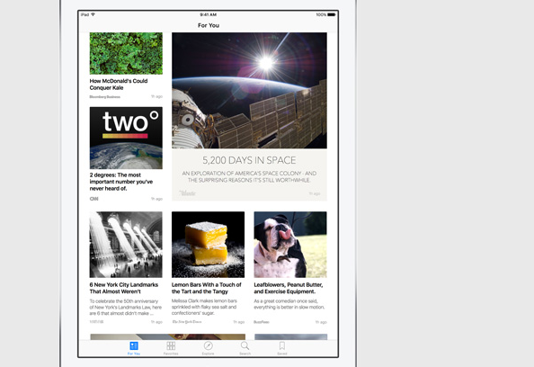
Gestión ‘bottom-up’ del conocimiento: Boards

Slide 12
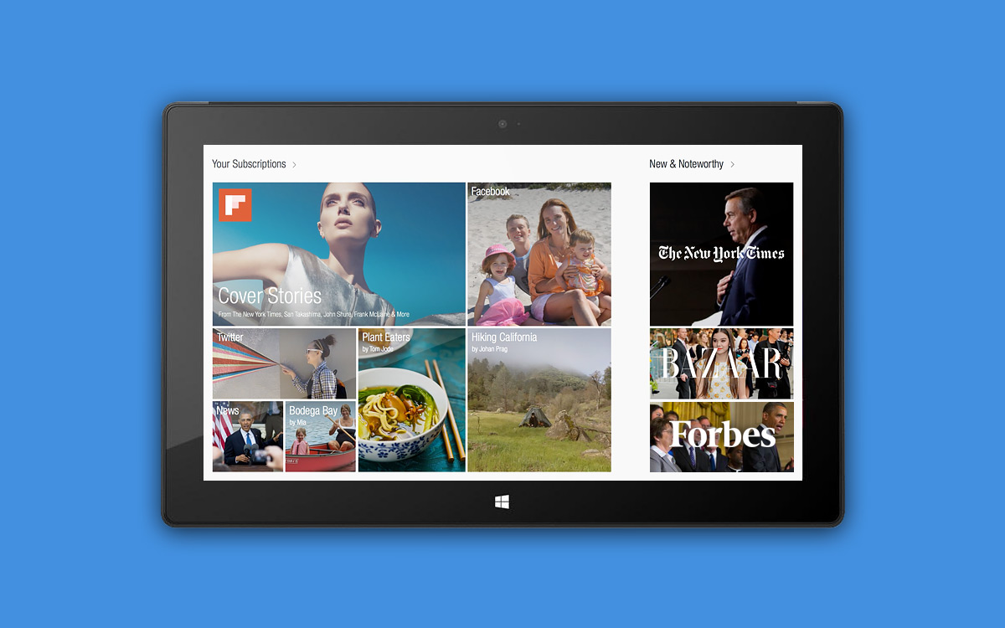

Slide 13
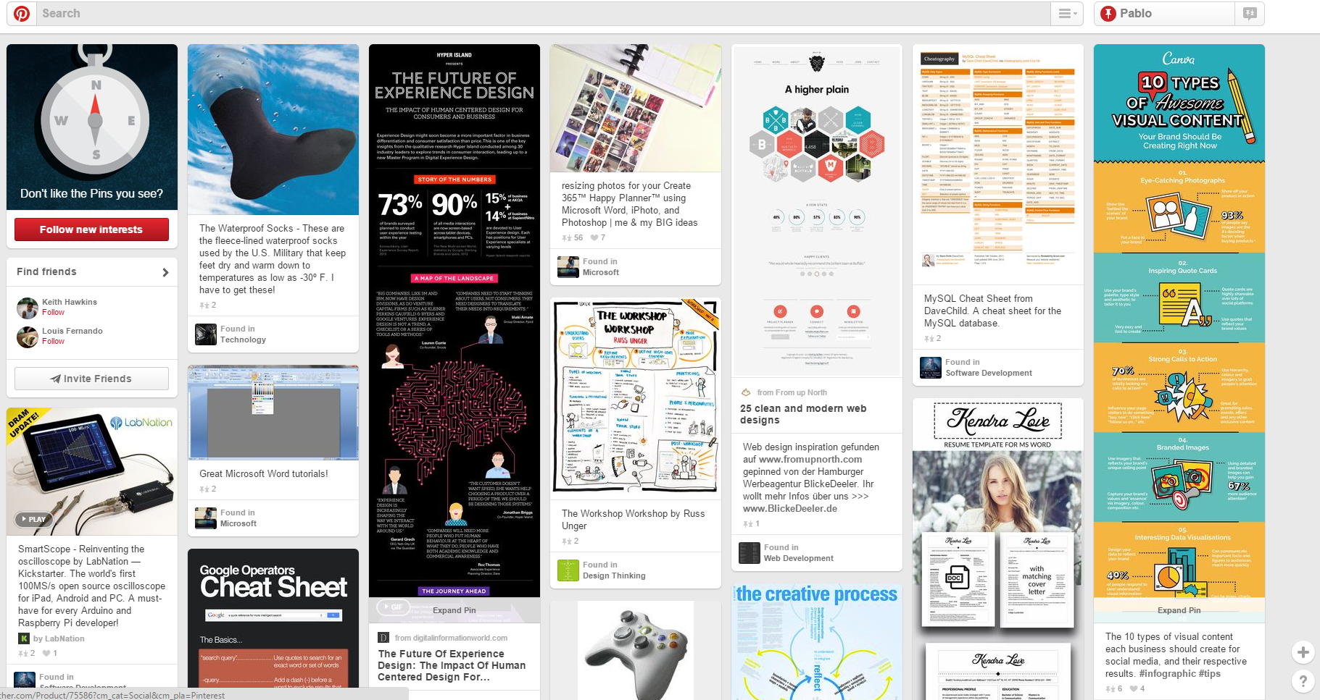

Slide 14
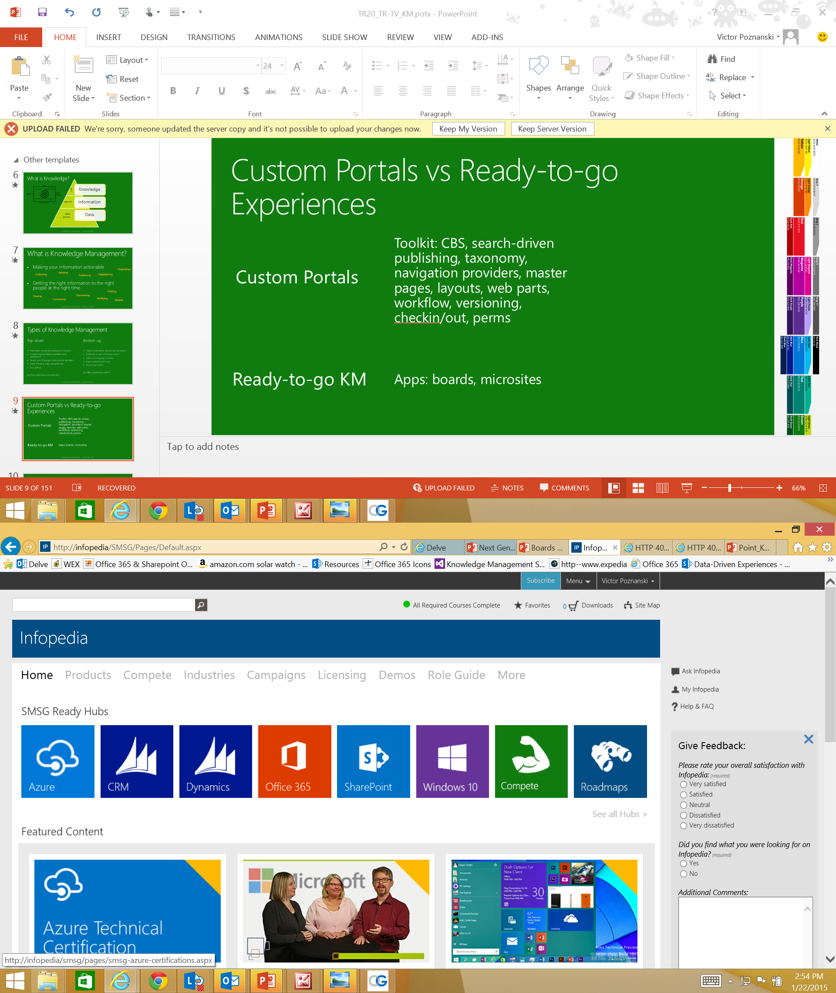
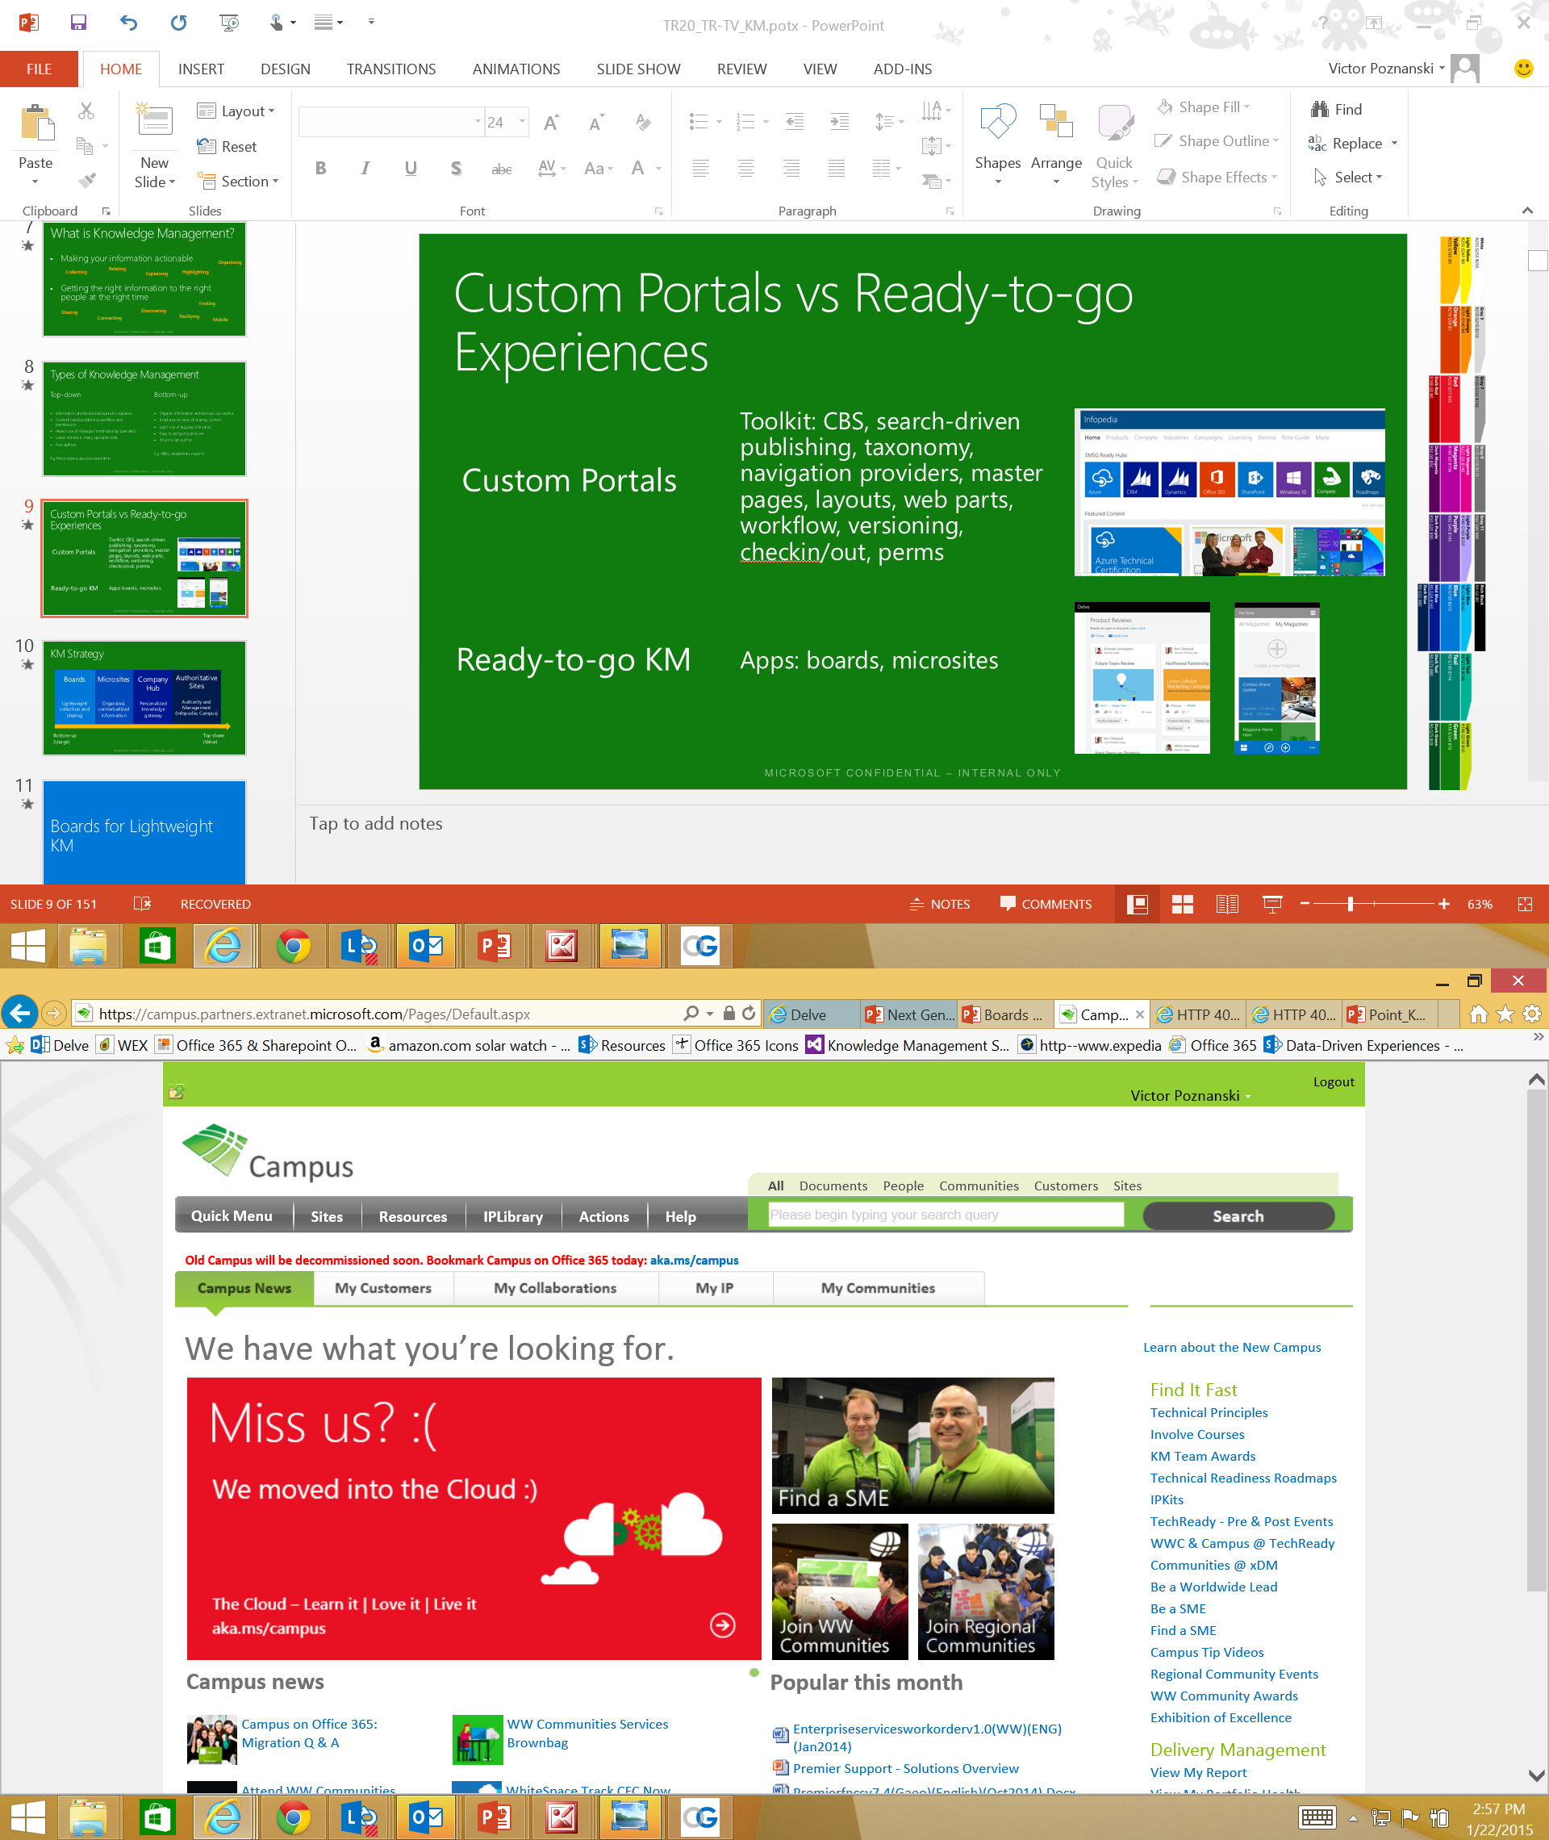
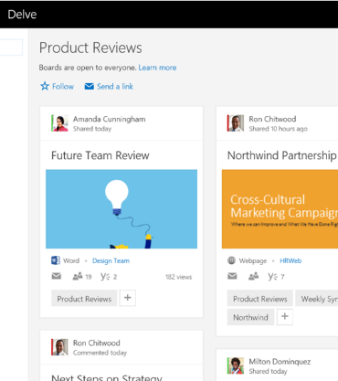

SharePoint Portals vs Ready-to-go Experiences
SharePoint Portals: Toolkit
CBS, search-driven publishing, taxonomy, navigation providers, master pages, layouts, web parts, workflow, versioning, checkin/out, perms…
Ready-to-go KM
Boards, microsites surfaced in Codename Infopedia

Slide 15



NextGen Portals: Meet the Family
O365 Video
Delve
O365 “InfoPedia”
Build Your Own
Video
Delve
“InfoPedia”
Your Portal
Intelligent
Mobile
Social
“Ready to go”
Enhanced by key Office 365 Capabilities
Office Graph
Office Add-Ins
OneDrive
Skype
Outlook
Compliance Center
Yammer
SharePoint Content Management
Azure Media & other Azure PaaS Services

Slide 16
KM Strategy
Boards
lightweight collection and sharing
Microsites
organized, contextualized information
Codename
Infopedia
personalized knowledge gateway
Bottom-up
(Usage)
Top-down
(Value)

Slide 17
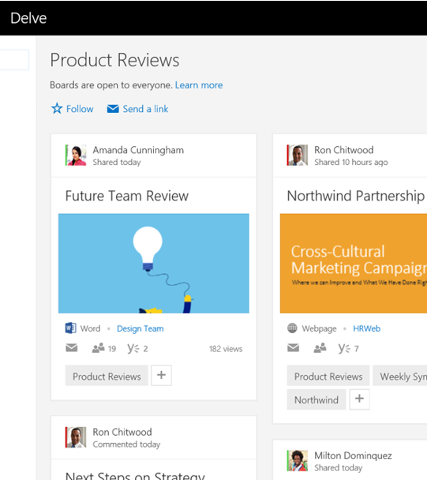
Collecting with Boards
Problem: Information gets fragmented and scattered
Boards are an easy way to collect and share fresh content
Collaborative: anyone can contribute and mail links
“add to board” is integrated into Delve

Slide 18

Boards

Slide 19
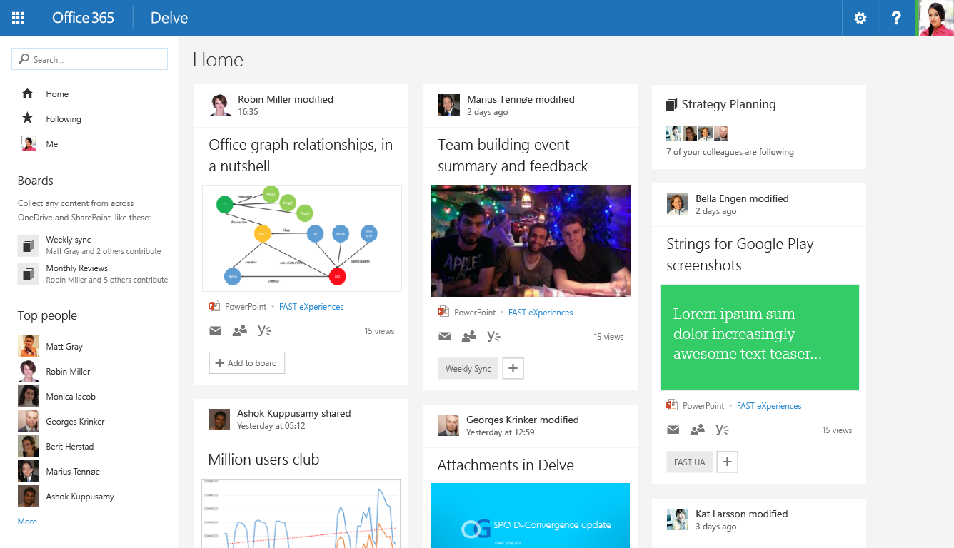
Drawing Attention to Boards
Ideas in the pipeline

Slide 20
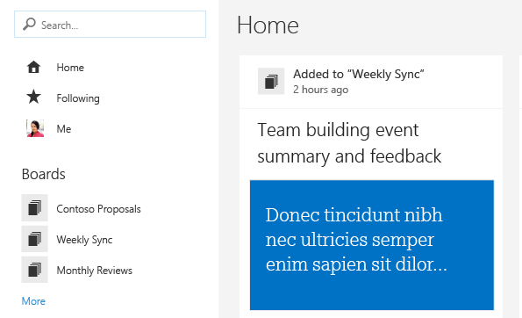

Attention/Notifications on Boards
Ideas in the pipeline
Changes to items on boards are ranked higher
Users receive digests mails of updates to boards

Slide 21
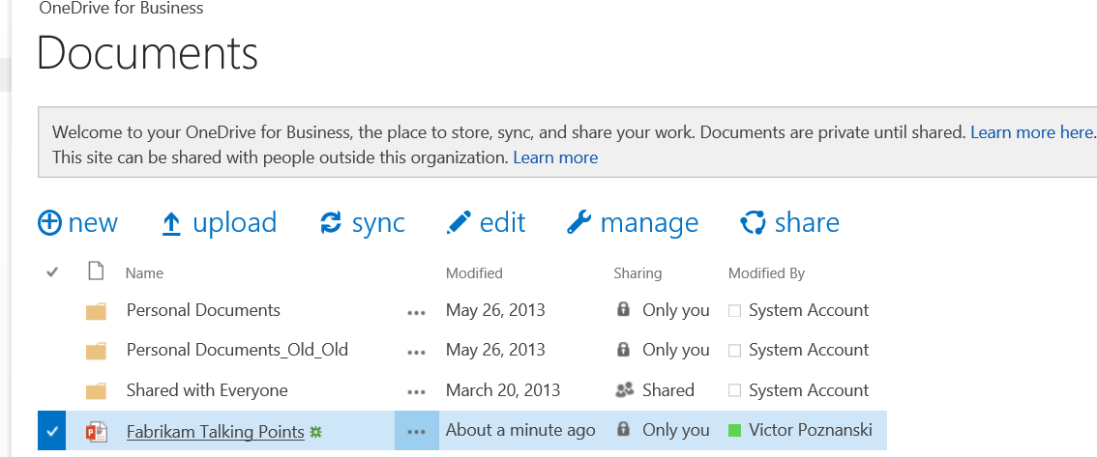

Boards Available Anywhere
The Ultimate Vision
You can add to a board anywhere in O365
Email
Onedrive for Business
Video, …
Add to Board
Abraham Beardsley

Slide 22
When should I use Boards?
When you want to pull together fresh information from different places and different people
When you want to focus attention on a subset of documents
When you want to re-use and build upon existing knowledge
What if I want more control over content curation?
…manage exactly who can add content
…order the content
…annotate, explain or provide context
...highlight or crack open certain content
…show related content
Notes:
Eg. Contributing to a company-wide topic Eg. The must-see documents in my group folder
Eg. All powerpoints for an offsite sitting on different Onedrives

Slide 23
KM Strategy
Boards
Microsite
s
Codename
Infopedia
Delve
O365 Video
Build Your Own
Delve
Video
“InfoPedia”
Your Portal
Bottom-up
(Usage)
Top-down
(Value)
Enhanced by key Office 365 Capabilities
Office Graph
Office Add-Ins
OneDrive
Skype
Outlook
Compliance Center
Yammer
SharePoint Content Management
Azure Media & other Azure PaaS Services

Slide 24
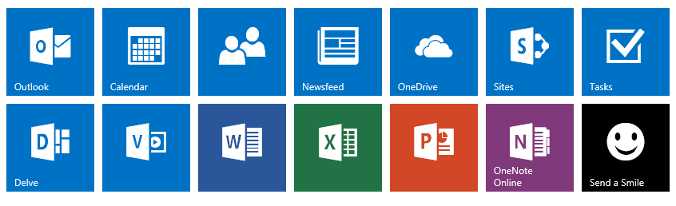
What does the Graph give you?
Me
related to
contributed
The Office Graph records relationships between people and O365 objects
It’s available throughout O365
You will be able to add to board from anywhere
We can derive great insights for you:
Who has contributed to this board?
Is anything happening on boards you care about?
Is there a board you should know about, because people close to you interact with it?
following
Sales Research
Fabrikam
added to
added to
trending around
modified

Slide 25
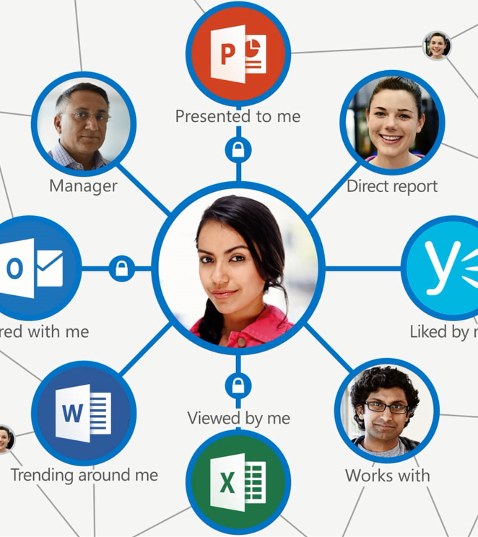
So what exactly is an Office Graph, and who is Delve?

Slide 26
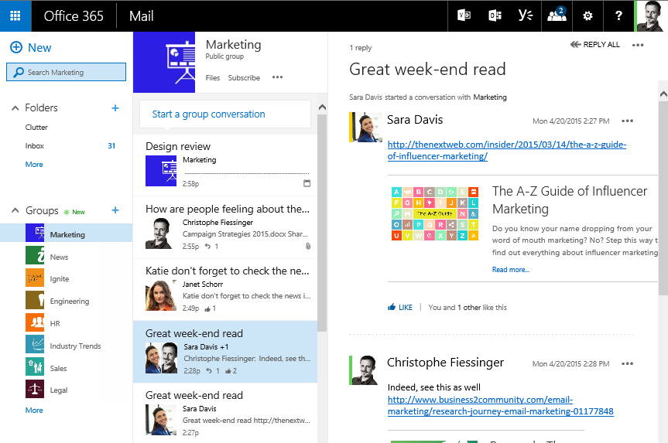
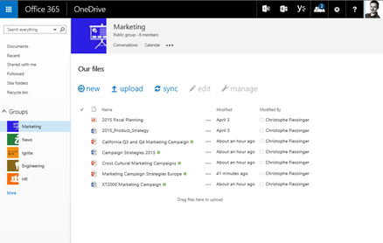
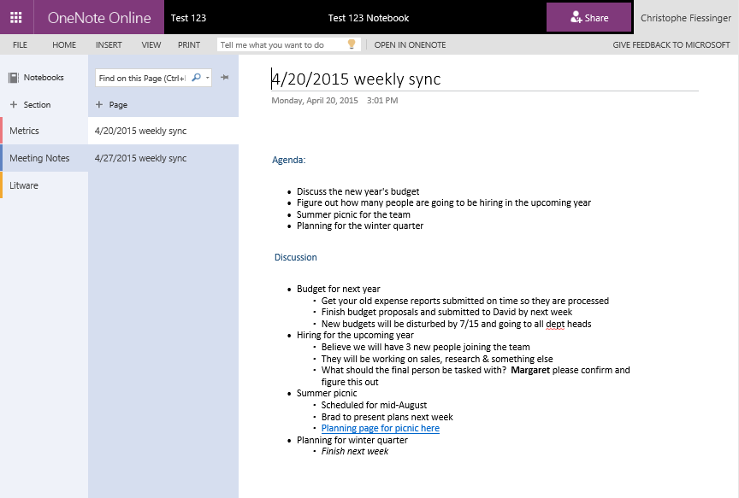
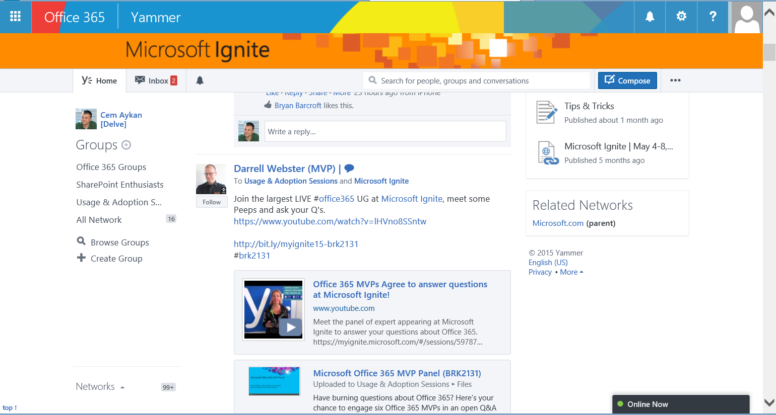
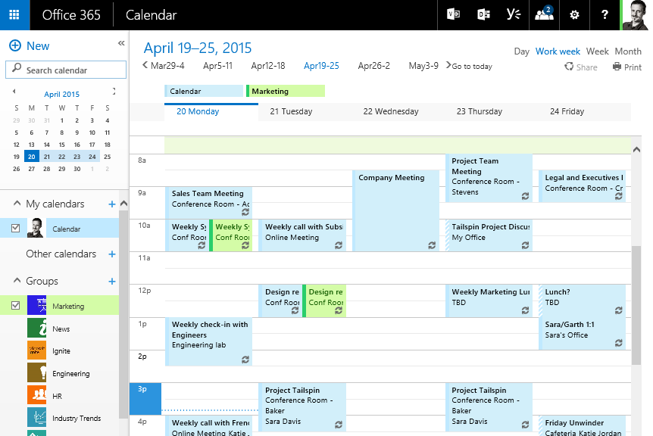
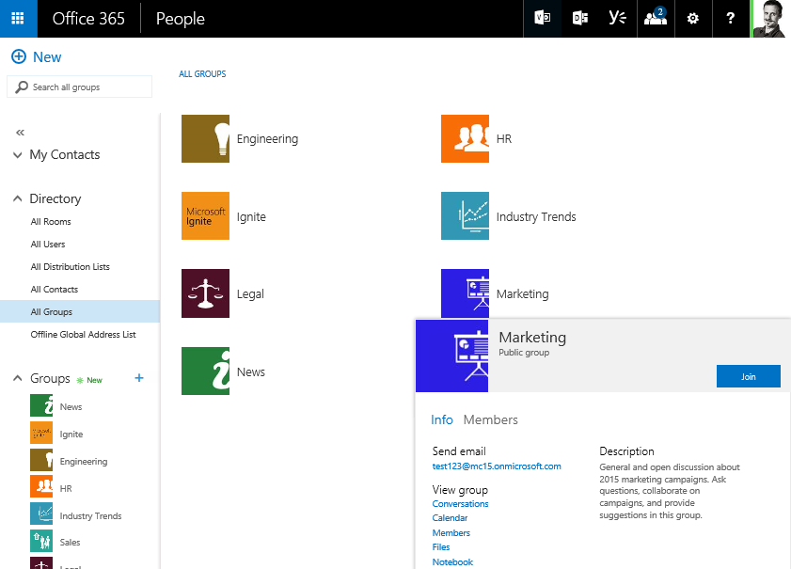
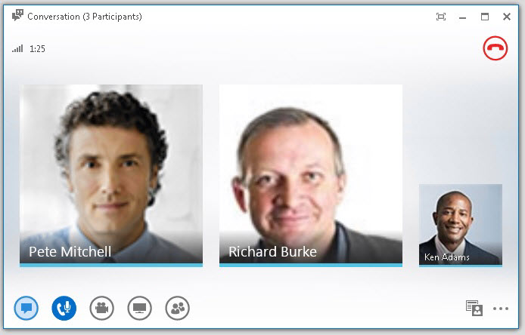
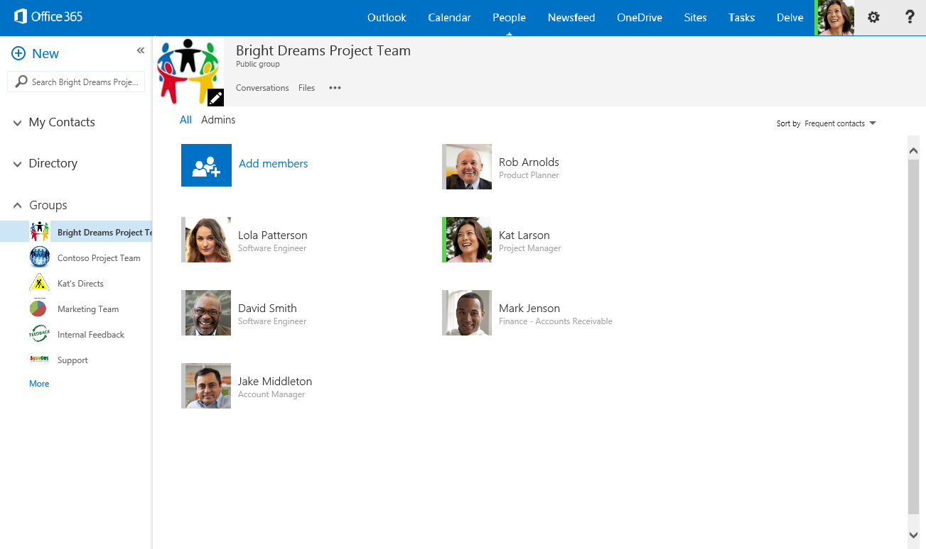
Today at work we use many different tools…
MAIL
FILES
ONENOTE
…
CALENDAR
Yammer
SKYPE

Slide 27
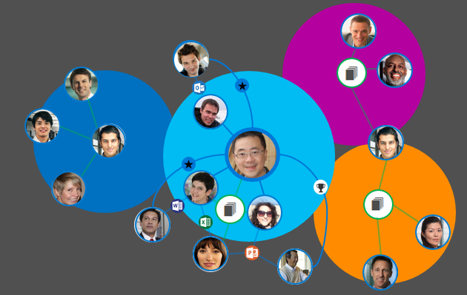
Today, siloed tools and teams…
Hierarchical and siloed teams

Slide 28

Who does what and who knows what?

Slide 29



People as proxy for information
How can I get back to a document?
ME
modifiedBy
shared
???
workingWith

Slide 30
People as proxy for information
ME

Slide 31
People as proxy for information
How can I stay informed?
MESSAGES
ME
EVENTS

Slide 32


People as proxy for information
FILES
MESSAGES
ME
EVENTS
TASKS

Slide 33



People as proxy for information
FILES
MESSAGES
manager
ME
EVENTS
workingWith
GROUPS
TASKS
memberOf
directReports
PEOPLE

Slide 34





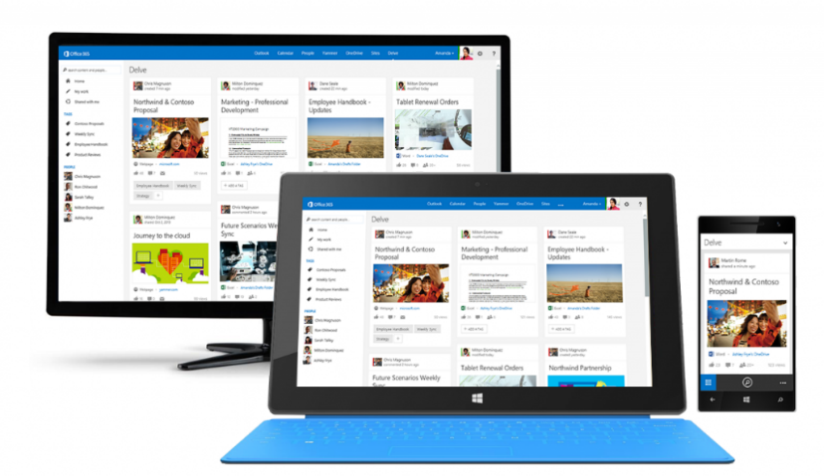
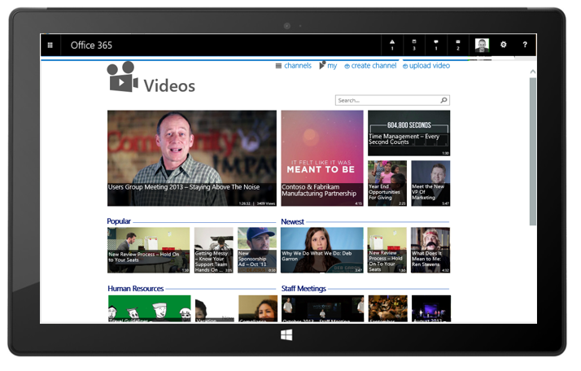
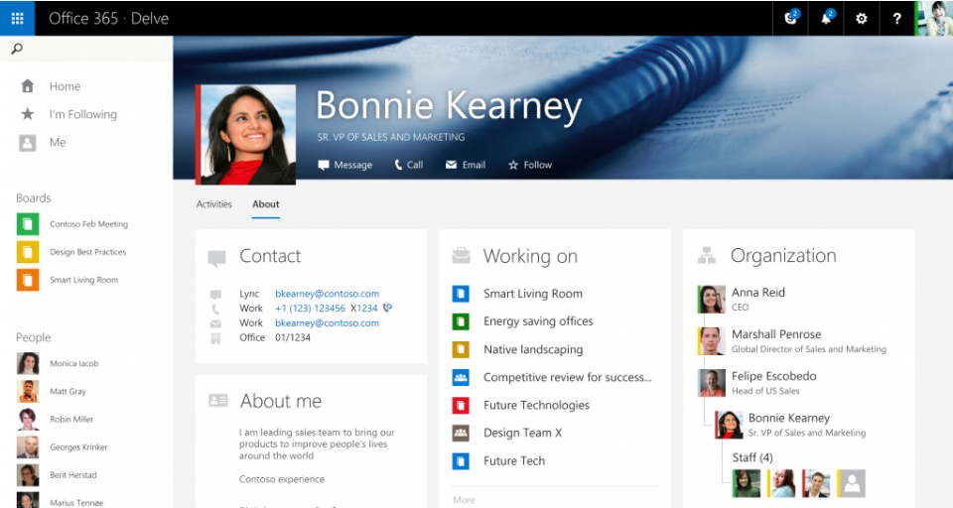
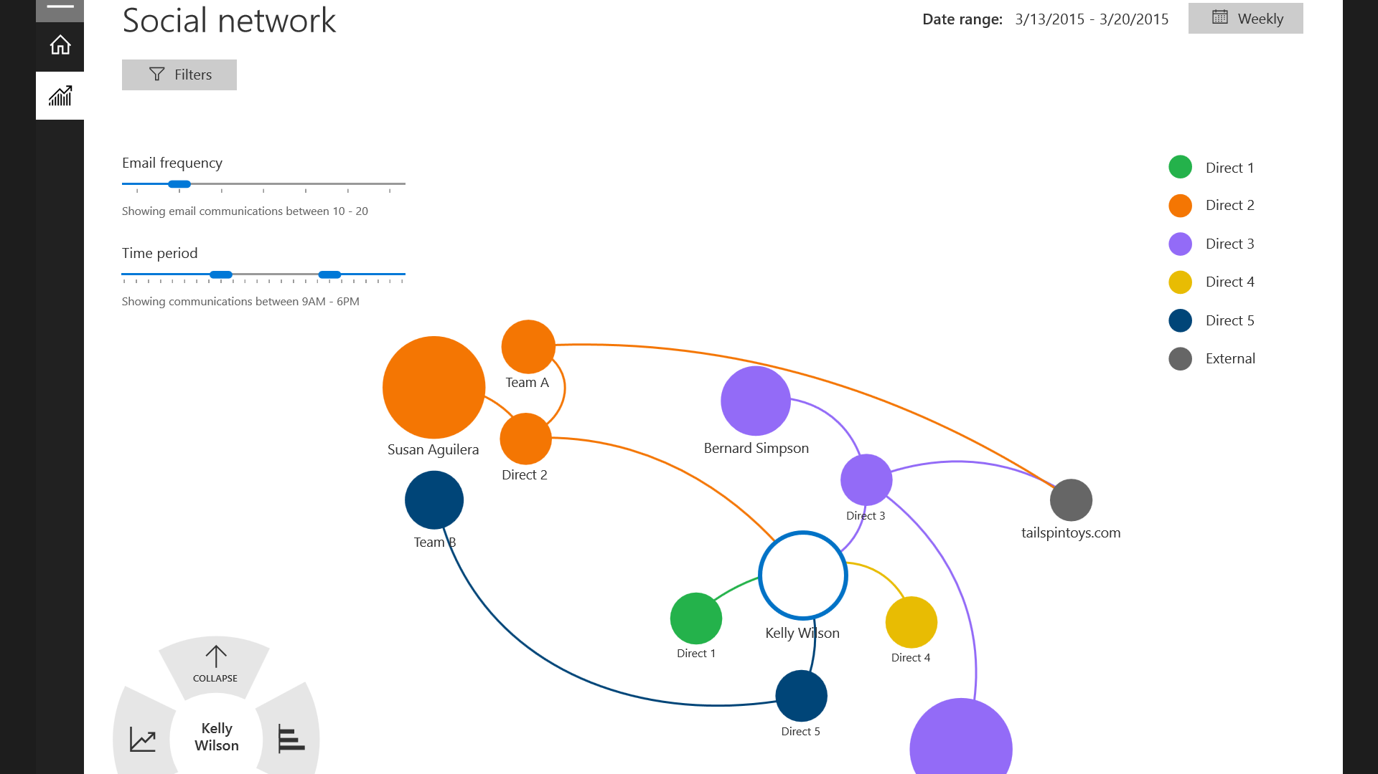
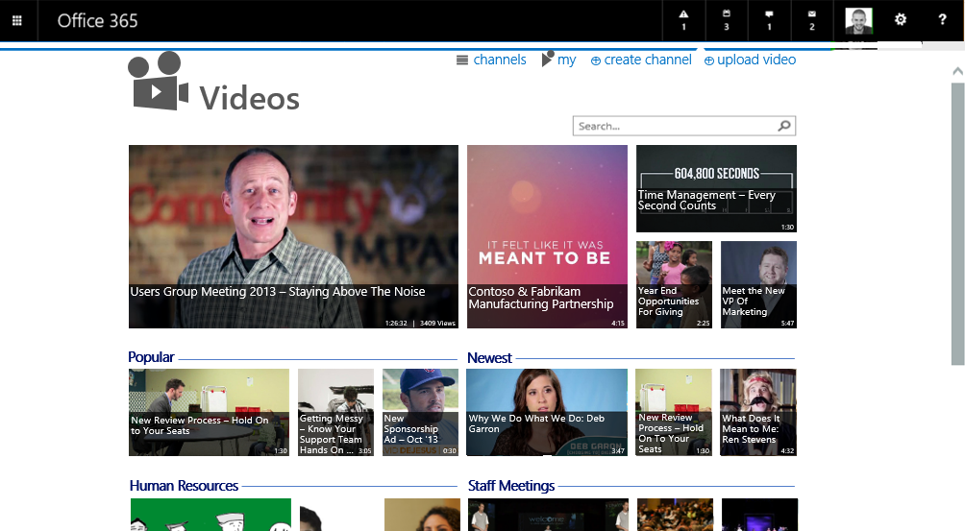
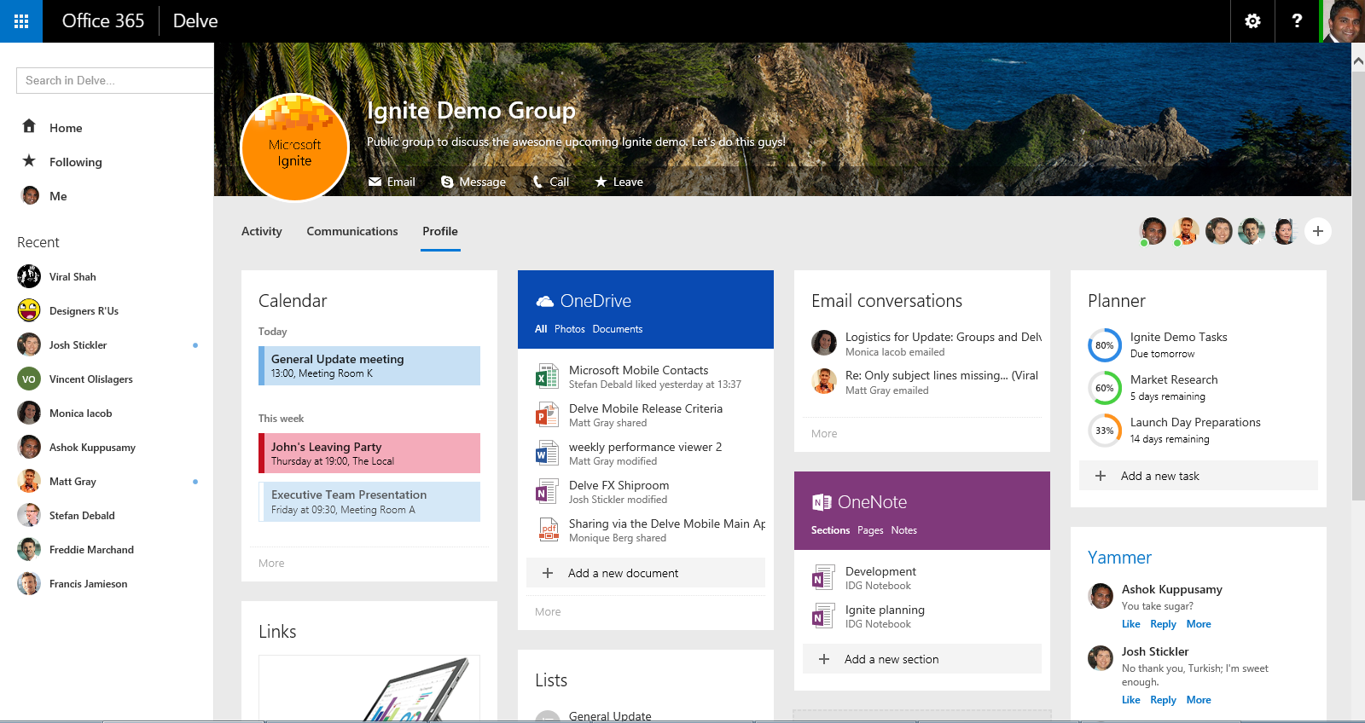
Natural Evolution of Delve
External
Exchange
SharePoint
Yammer
Lync
Office Graph
+
Search & Discovery of Content
People Insights
Group Insights

Slide 35
Delve Demo Now & Future

Slide 36
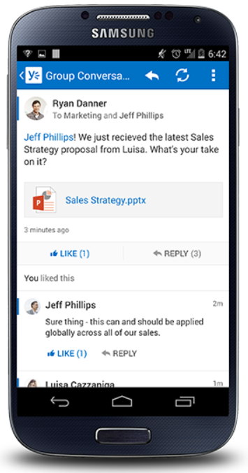
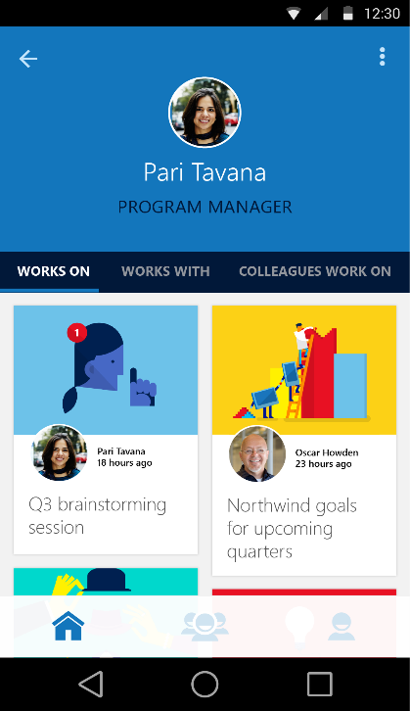
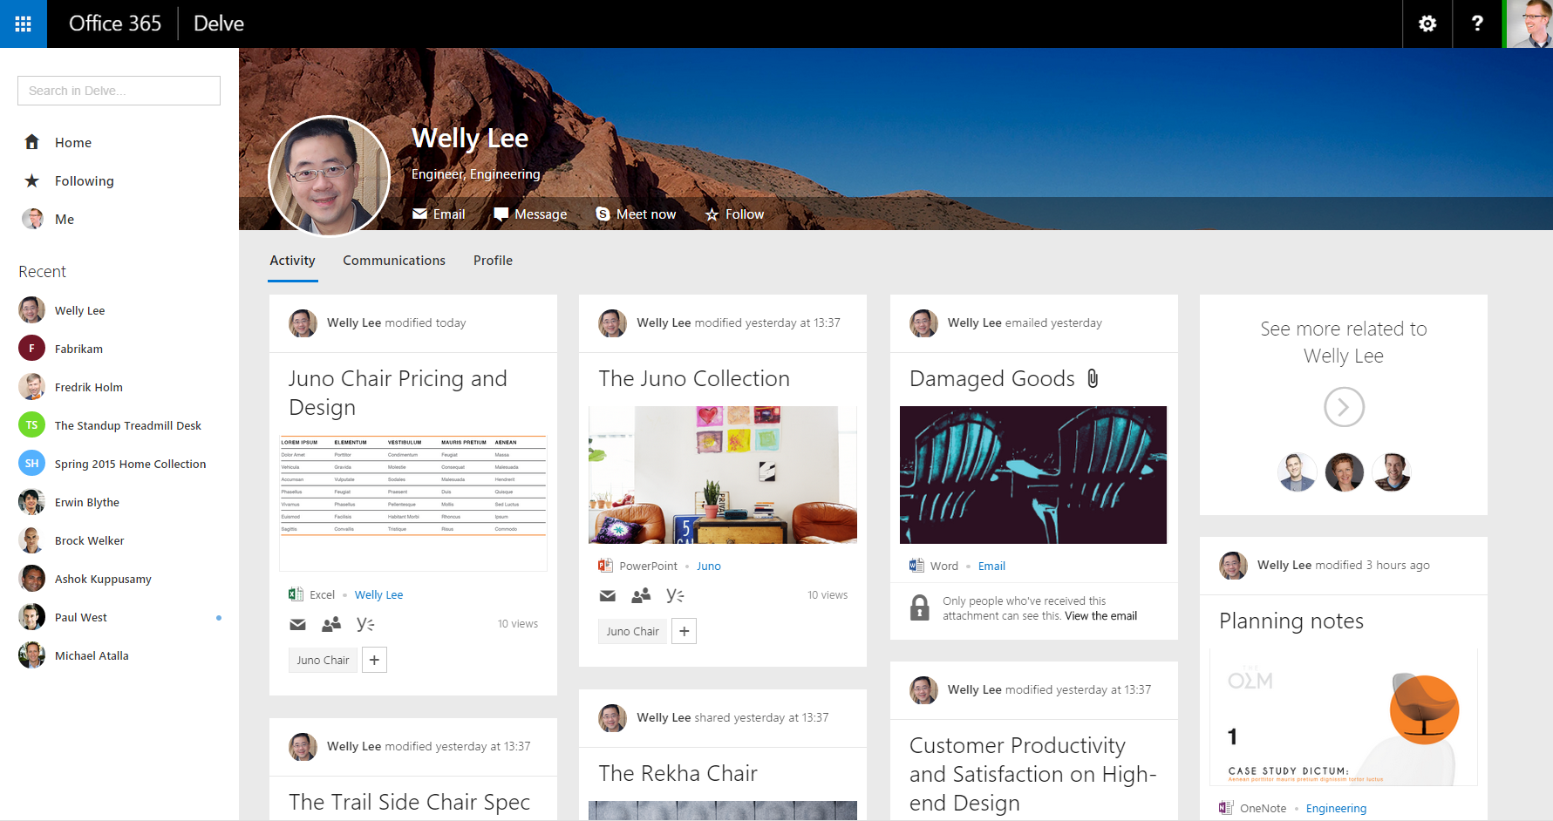
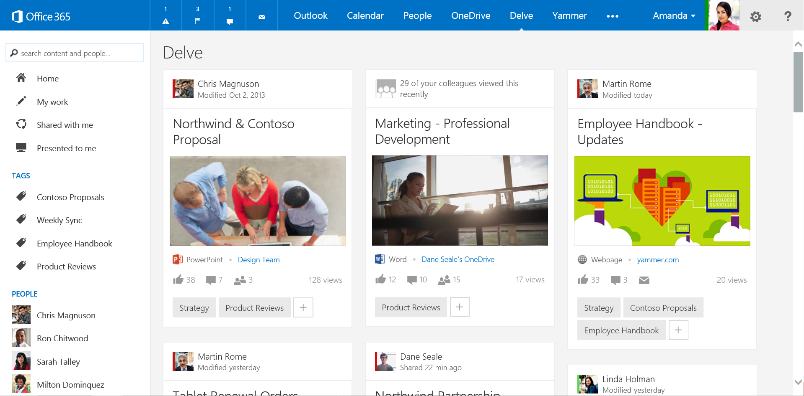
Finding Content through People
http://aka.ms/DelveAndroid
http://aka.ms/DelveIphone
Stay informed and productive even on the go
People as proxy to information.

Slide 37
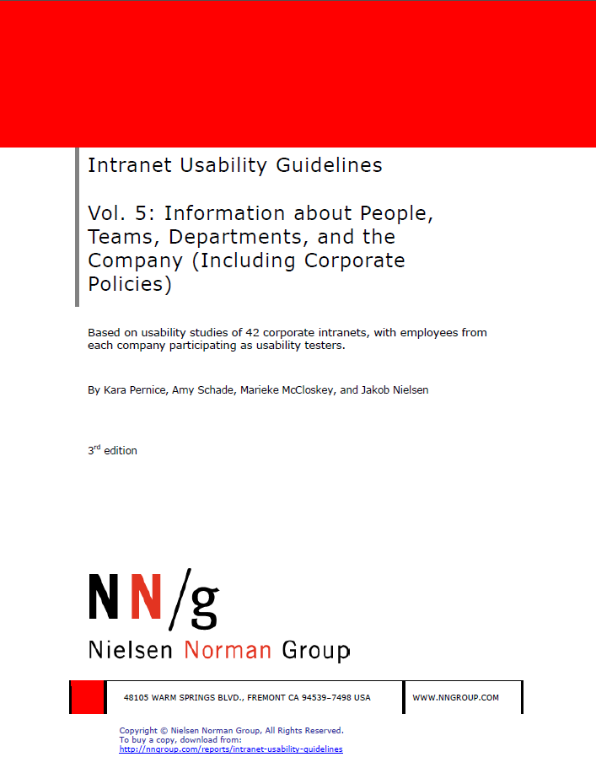
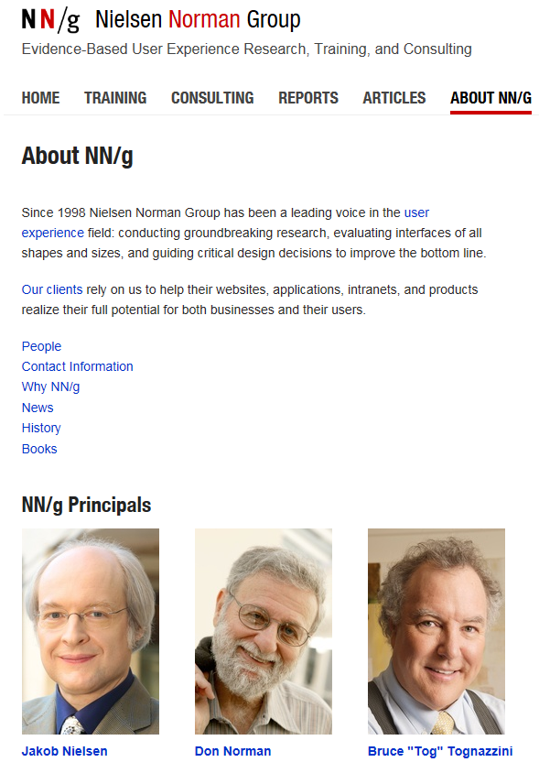
People Discovery
“Whether a company is large or small, international or local, has tens of thousands of employees or less than 50, its people always need information about one another”
http://www.nngroup.com/

Slide 38
Office Graph

Slide 39

/users
manager
ME
Workswith
GROUPS
memberOf

Slide 40
/messages
MESSAGES
manager
ME
directReports
GROUPS
memberOf

Slide 41
/events
MESSAGES
MESSAGES
manager
ME
directReports
EVENTS
GROUPS
memberOf

Slide 42

/files
MESSAGES
manager
ME
modifiedBy
directReports
shared
directReports
directReports
EVENTS
EVENTS
FILES
GROUPS
memberOf

Slide 43
/groups
MESSAGES
manager
ME
modifiedBy
shared
modifiedBy
directReports
shared
directReports
EVENTS
FILES
FILES
GROUPS
GROUPS
memberOf
memberOf
modifiedBy
createdBy

Slide 44

/groups
MESSAGES
CONVERSATIONS
manager
ME
modifiedBy
directReports
shared
EVENTS
workingWith
FILES
GROUPS
memberOf
modifiedBy
modifiedBy
createdBy
createdBy
FILES

Slide 45
/workingWith
MESSAGES
CONVERSATIONS
CONVERSATIONS
manager
ME
modifiedBy
directReports
shared
EVENTS
EVENTS
workingWith
FILES
GROUPS
GROUPS
memberOf
memberOf
modifiedBy
workingWith
createdBy
FILES

Slide 46
/trendingAround
MESSAGES
CONVERSATIONS
trendingAround
manager
ME
directReports
shared
modifiedBy
EVENTS
workingWith
workingWith
FILES
GROUPS
memberOf
modifiedBy
workingWith
workingWith
trendingAround
createdBy
FILES

Slide 47
Office Graph
MESSAGES
CONVERSATIONS
trendingAround
manager
ME
directReports
shared
modifiedBy
EVENTS
workingWith
FILES
TASKS
NOTES
GROUPS
memberOf
modifiedBy
workingWith
trendingAround
createdBy
FILES

Slide 48

Signals
Click/Open
Share
Social comments
Presented to
Search
Modify/Save
Follow
Email
Meetings
Lync
Social gestures
Video
Ignore
External API/Partner/etc..

Slide 49
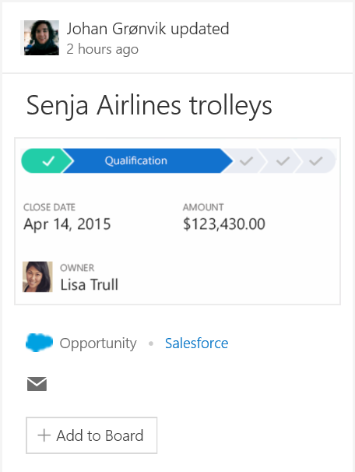
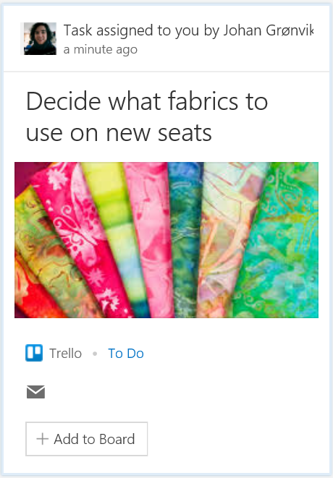

Office Graph Extensibility
GQL
Content & Enrichment API’s
Query API’s
1
2
Ability to connect to LOB and 3rd party services
Expand coverage and value of first party apps
Classification, concept and expertise detection
SharePoint 2016 – Hybrid connectivity
Sneak peak @ Build/Ignite
Graph Query API’s for building rich apps
Sprinkle intelligence to existing apps
Access data from across workloads vs silo
Preview @ Build/Ignite

Slide 50

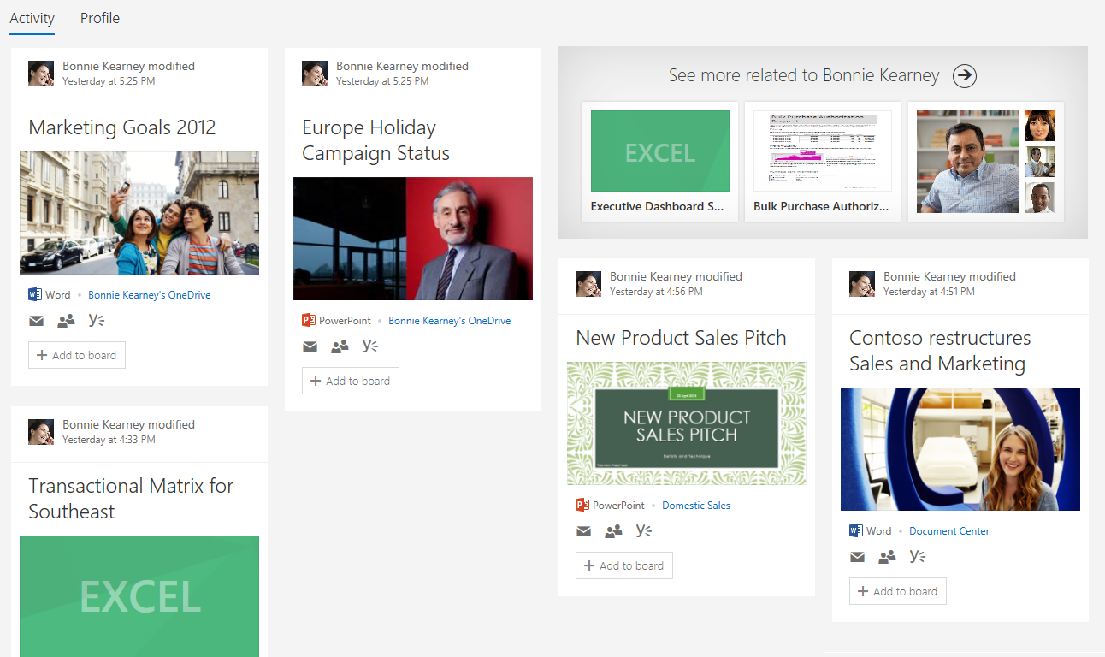
People Experiences in Delve
Coming Soon
Finding Content through People
Finding People through Content
Why people?
Evolution of Delve
A few slides
Wrap-up

Slide 51
Group Insights in Delve
Near Future
Discover and connect through Groups
Delve stitches together all recent activity around a group for quick insights and access
Easily get back to the people and groups that matter most

Slide 52
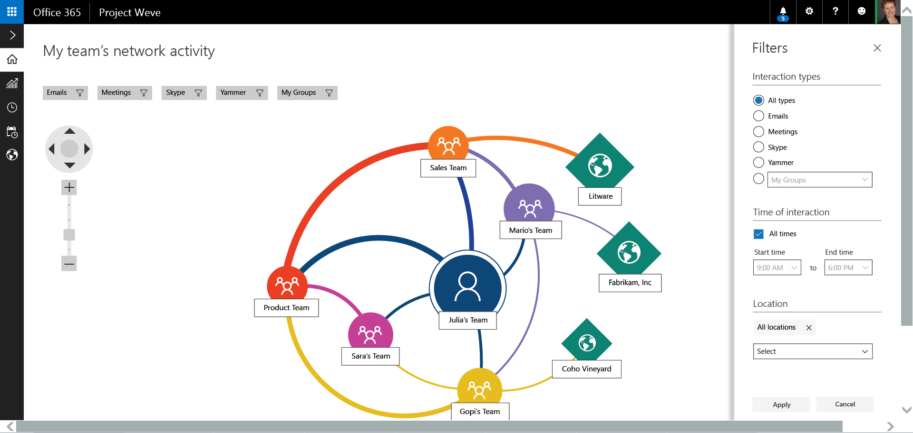
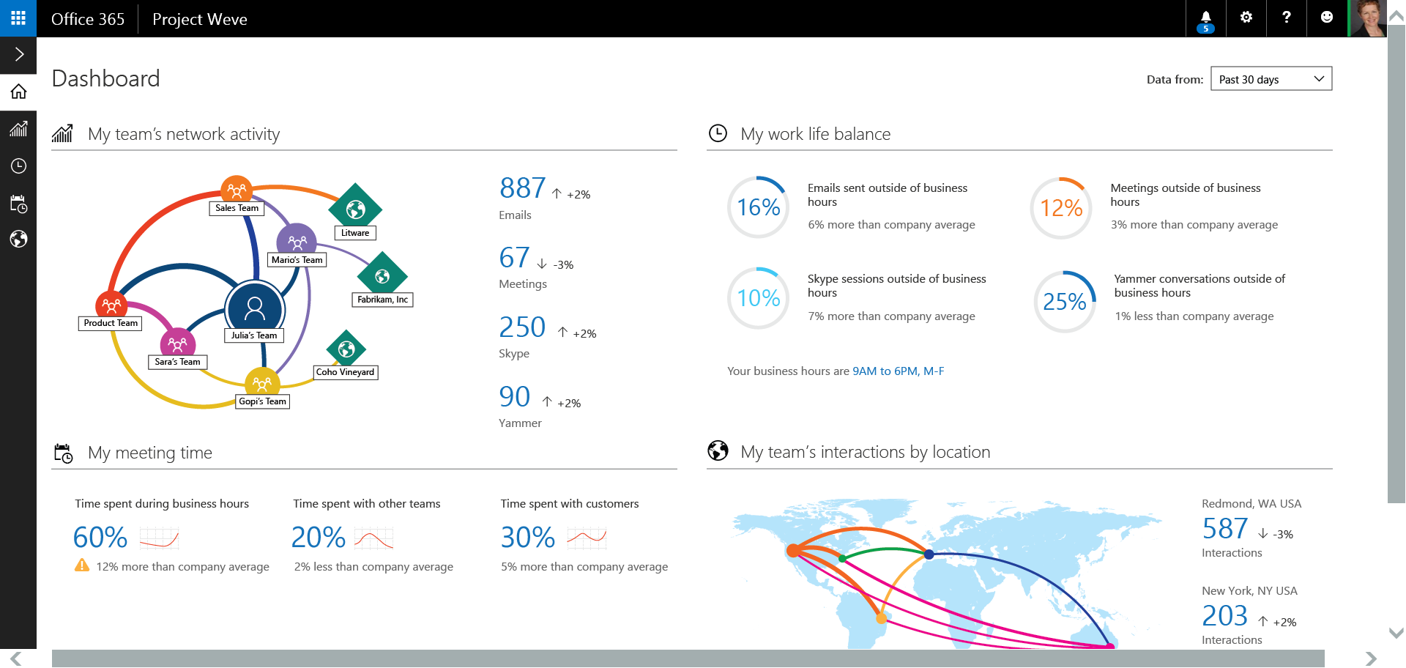
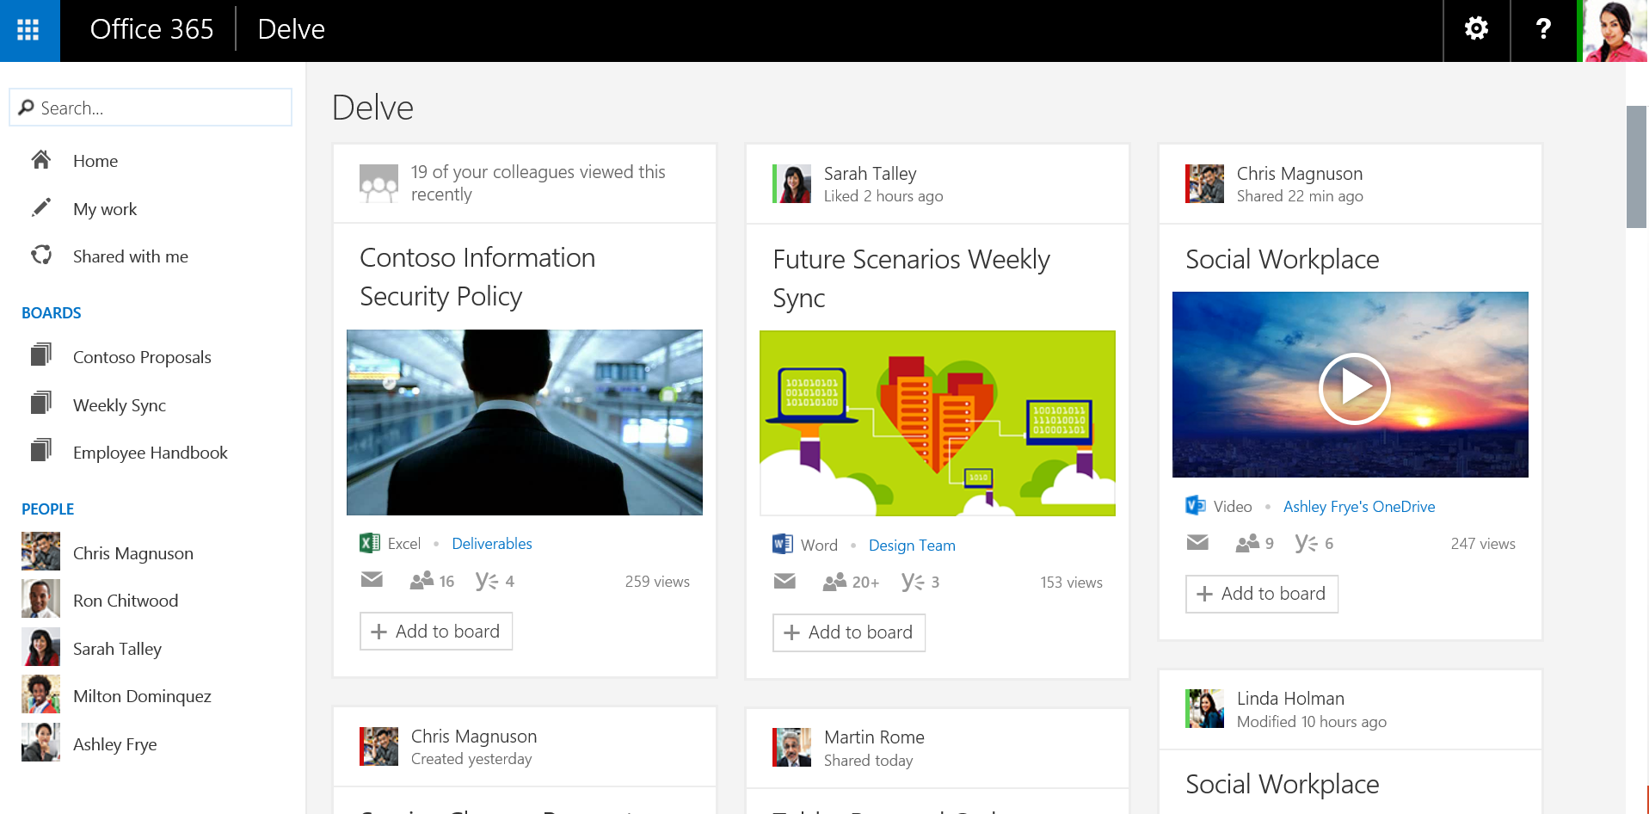
Organizational Insights
Future
Drill down on time spent on various activities and identify patterns
Rich Interactive dashboards, promoting visual discovery and insights for people and teams
Identify opportunities to improve cross team collaboration.

Slide 53

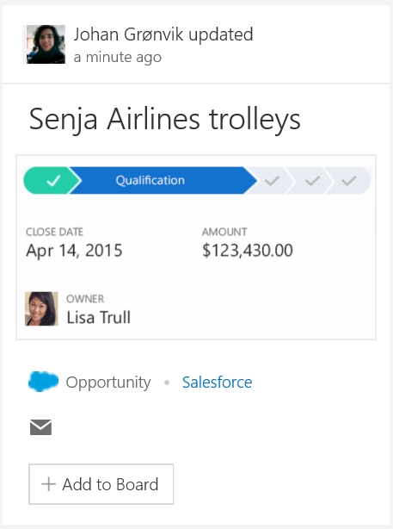
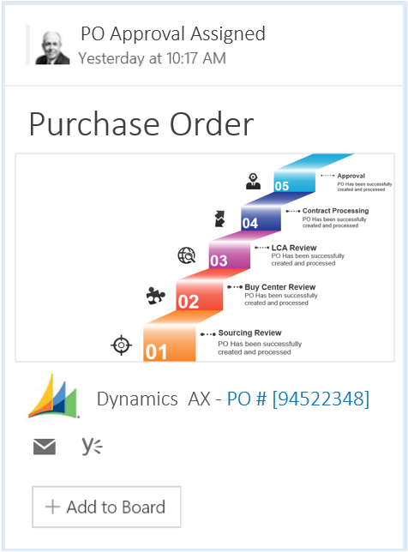
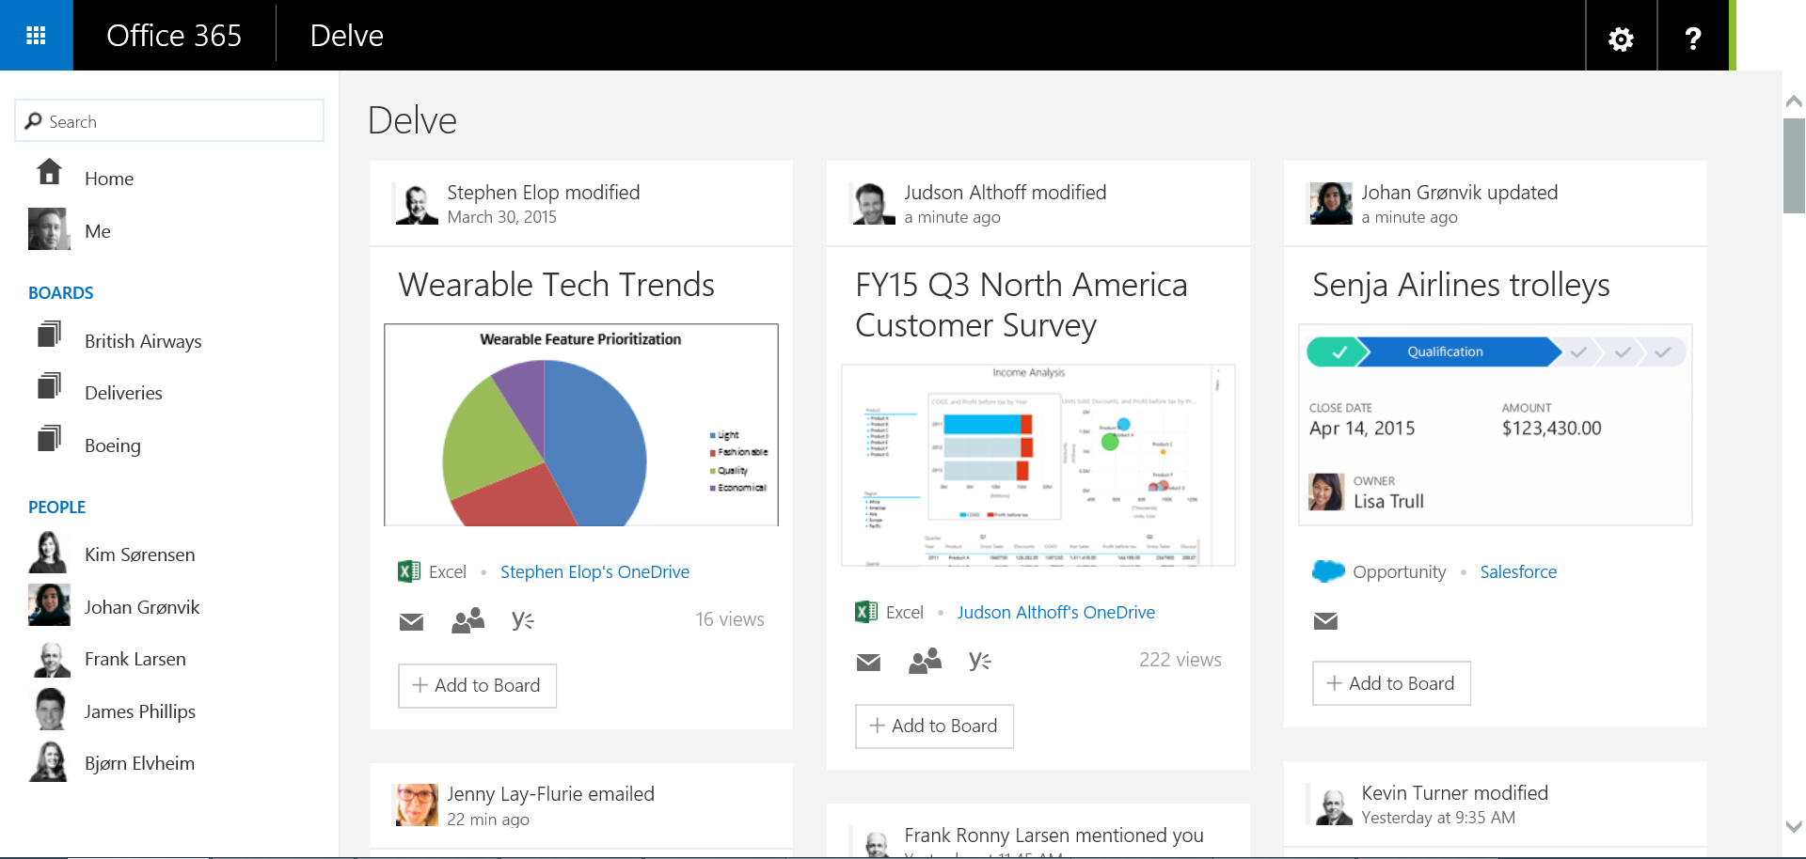
Extensibility

Slide 54






Public and Private Signals Always Respect Permissions
Email
Presented to me
Manager
Direct report
Shared with me
Public Groups
Viewed by me

Slide 55
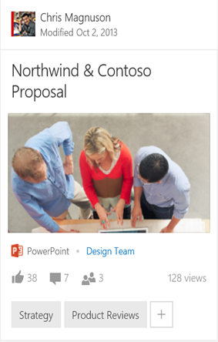
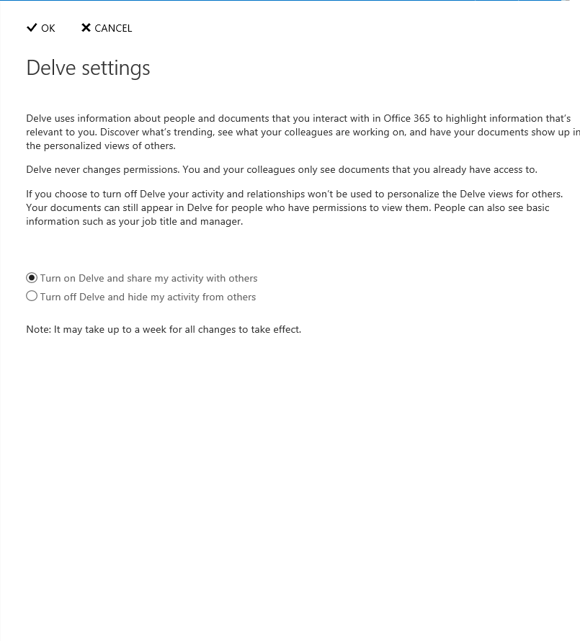
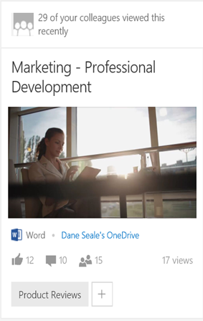
Transparency and Control
Insights on how this relates to you
Both tenant and user level opt-in/opt-out settings
Discovery that respects permissions
Control access to your content and share with others

Slide 56

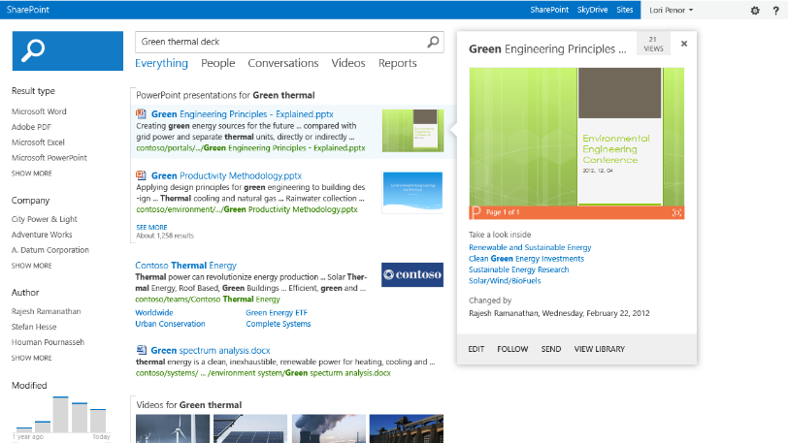
Search vs Discovery
+
User Experience
Enterprise search center
Personalized discovery experiences, assistants
Management
Query management
Governance controls
Extensibility
Content and connector frameworks
Office Graph connectors, API’s and hybrid support

Slide 57
“Knowledge is promiscuous. It mates and gives birth to more knowledge.” - Alvin Toffler, American Writer and Futurist

Slide 58
You can´t miss these…
Session | Code | Time | Room
Team Collaboration in the Connected Workplace | BRK1106 | Mon May 4, 1:30pm | S104
Microsoft Office 365 Groups Overview and Roadmap | BRK2114 | Tue. May 5, 9:00am | S103
Office Delve and Office Graph Vision and Roadmap | BRK1105 | Tue. May 5, 10:45am | S102
Building Solutions with Office Graph | BRK3193 | Tue. May 5, 5:00pm | N227
A New People Experience in Delve: Discover People Through Content, and Content Through People | BRK2176 | Wed. May 6, 10:45am | E353
Break Down Organizational Silos and Gain New Insights with Office Graph and Office Delve | BRK2107 | Wed. May 6, 3:15pm | S103
MVP Panel: Sample Apps and Intelligent Solutions Showcasing Office Graph and Delve Extensibility | BRK3154 | Wed. May 6, 5:00pm | E351
Big Bang: The New Universe of Findability and Discoverability | BRK3165 | Thur. May 7, 1:30pm | E451B

Slide 59
Q&A
@pabloperis
pablop@microsoft.com

